Slide 1
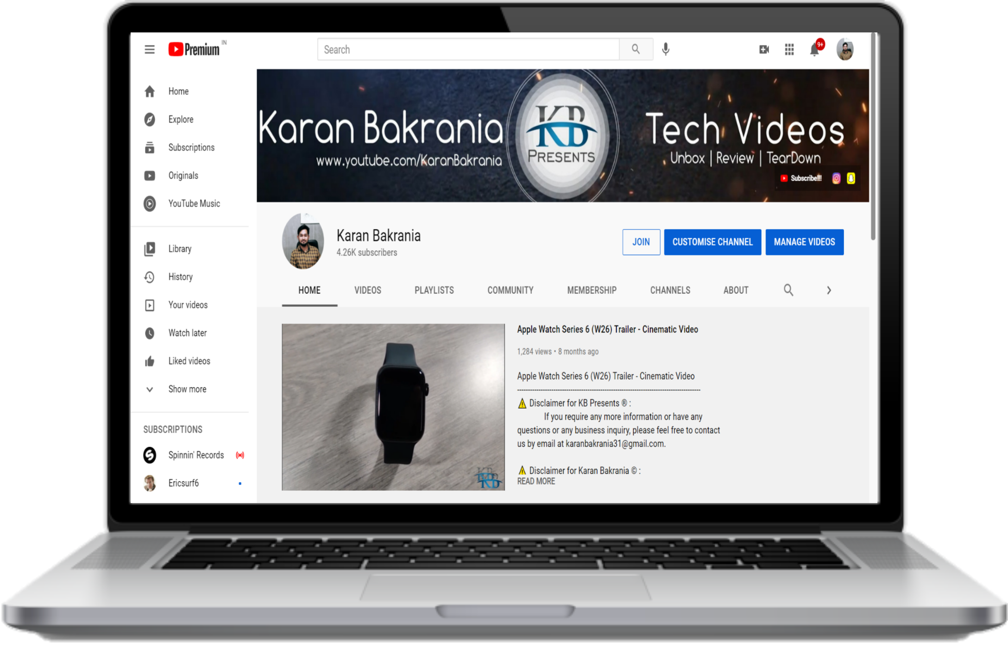
KB Presents
Where products get Torn Apart
Founder:
Karan Bakrania

Slide 2
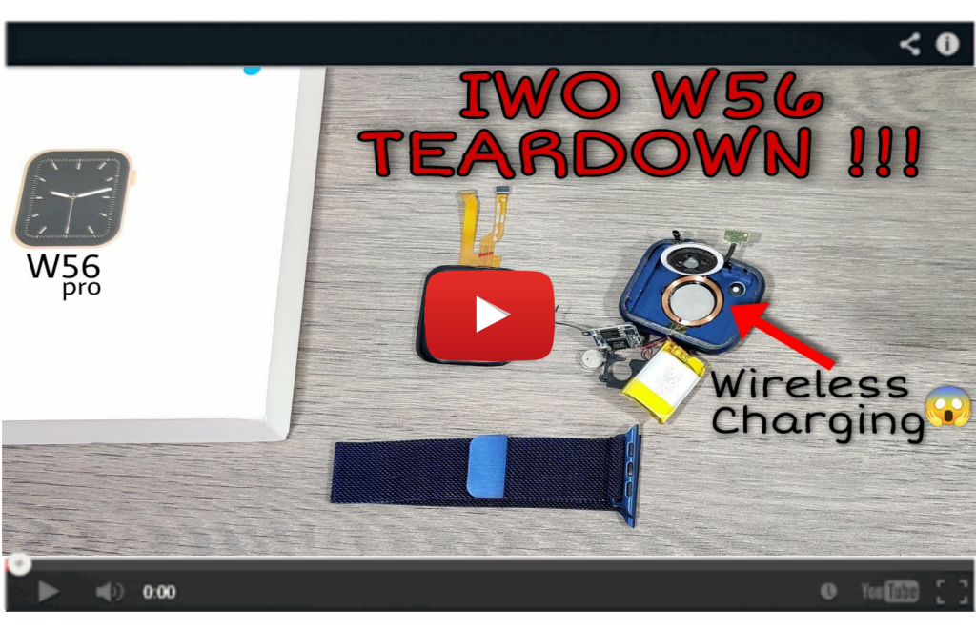
Karan Bakrania
KB PRESENTS
This is our Technical Channel and we review all latest gadgets and also make Teardown videos to aware our audience as to how complex and nano the technology is getting day after another.
Home
Profile
Most Viewed video
Library
Subscriptions
Trending
Help
DT100 Series 6 Smart Watch Unboxing & Review | 100+ Watch faces | 60Hz Refresh Rate | Passcode Lock
DT100 Smart Watch TEARDOWN !!! | Real Heart Rate Sensor | What's Inside DT100...
IWO W56 Smart Watch TEARDOWN | What's inside W56 smartwatch. | Wireless Charging In W56.
FK99 Pro / DW35 Pro Series 6 Smartwatch Unboxing & Review | FK99 pro GIVEAWAY !!!

Slide 3
KARAN BAKRANIA
KB PRESENTS
UNBOXING | REVIEW | TEARDOWN
Home
Profile
Here you will find all variety of tech videos and cool gadgets and also get chance to see what's inside, as inner beauty is equally important as outer beauty. All this is Available right here on KARAN BAKRANIA.
Most Viewed video
Library
Subscriptions
Trending
Visit Our Channel
Help

Slide 4
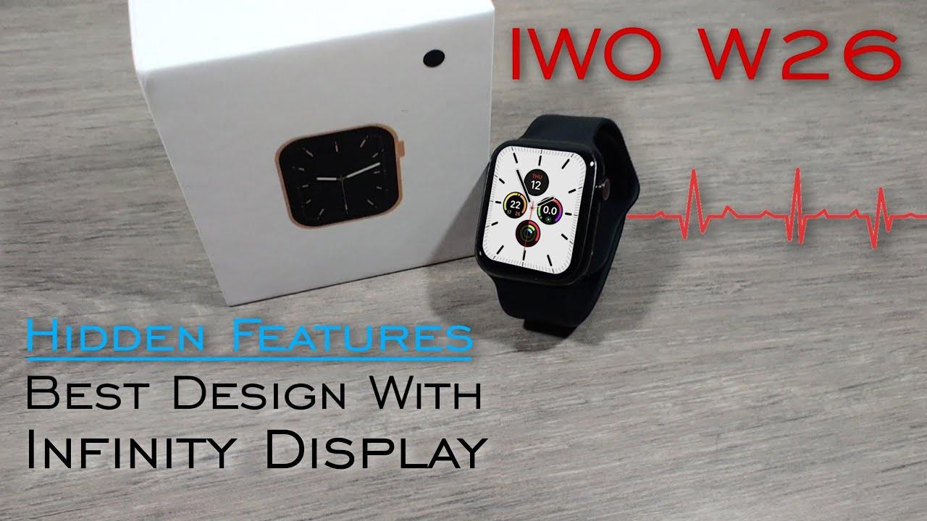
Dated on 07/06/21
KB PRESENTS
Home
Profile
Most Viewed video
Library
Subscriptions
Trending
29-Sep-2020
Views
Help
Apple Watch Series 6 (W26) Smartwatch Unboxing And Review
2,19,730
This is the first clone of apple watch series 5 with infinity display. Means, the display size is bigger than previous models or any other apple watch replica. Due to its bigger size 1.75 inches and this w26 watch provide 90% body to screen ratio. As well as the screen is 450 nits brighter which provide excellent views during day time. This IWO w26 watch also equipped with MediaTek Chipset which is new and latest.
2864
128

Slide 5
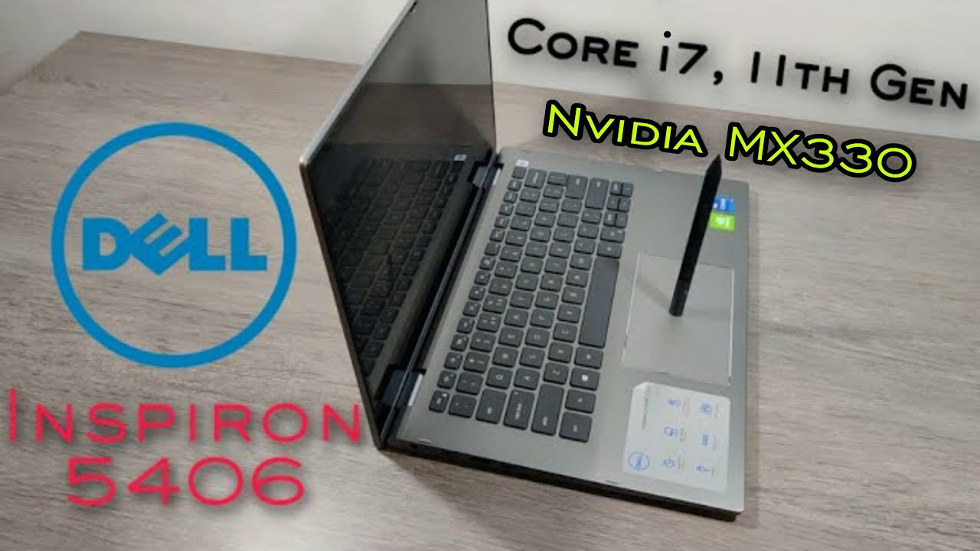
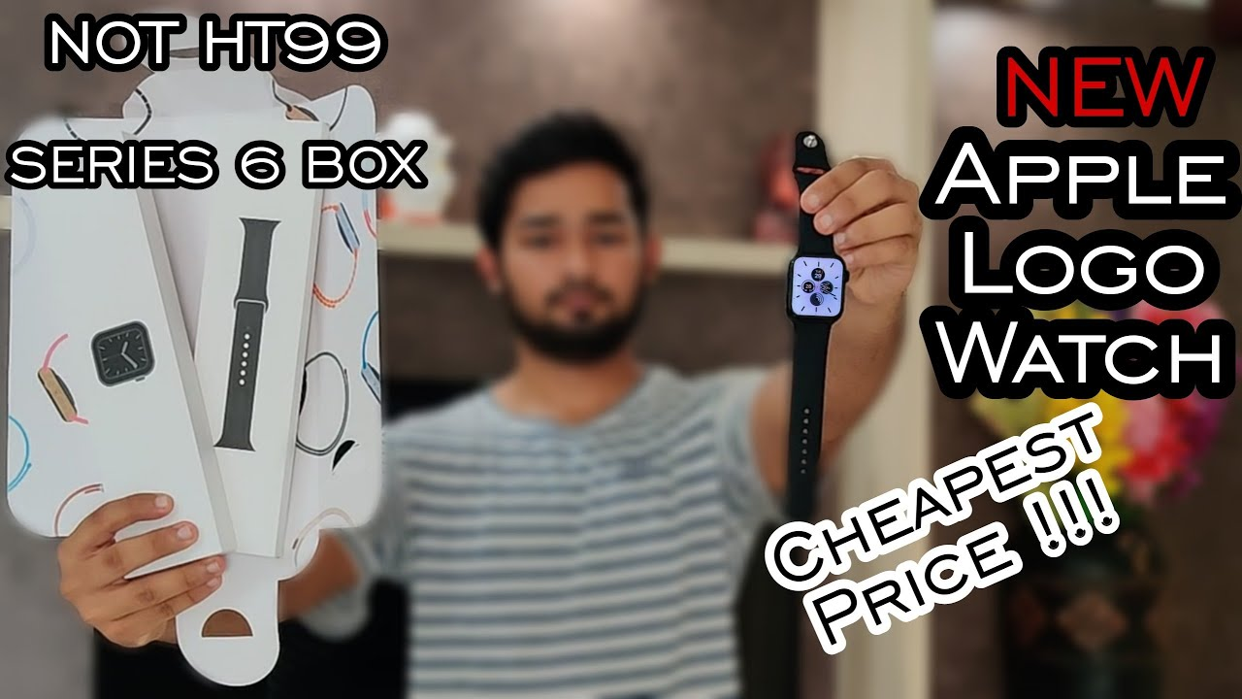
Dashboard
History
KB PRESENTS
Home
10:46
12:06
12:15
13:58
Profile
Dell Inspiron 5406 14 Inch Laptop | Core i7 11th Gen, Nvidia MX330 | 2n1 Touch Screen Light & Compact
NEW Apple Logo Watch Series 6 | Better Than HT99 & K16 | Cheapest Apple Logo Watch
W56 Pro Series 6 Smart Watch Unboxing And Review | 1:1 Copy Apple Watch | First Time In INDIA
Apple Watch Series 6 (W26) Smart Watch Unboxing And Review | Hidden Features Of IWO W26 BEST REPLICA
Most Viewed video
Library
Subscriptions
Trending
Help
Playlist
Watch later
Liked video

Slide 6
Geographical Views
KB PRESENTS
Home
United Kingdom
India
80%
55%
Profile
Most Viewed video
United States
United Arab Emirates
35%
75%
Library
Subscriptions
Country name v/s Views
INDIA
41,618
Trending
Help
UNITED STATES
26,532
UNITED KINGDOM
17,834

Slide 7
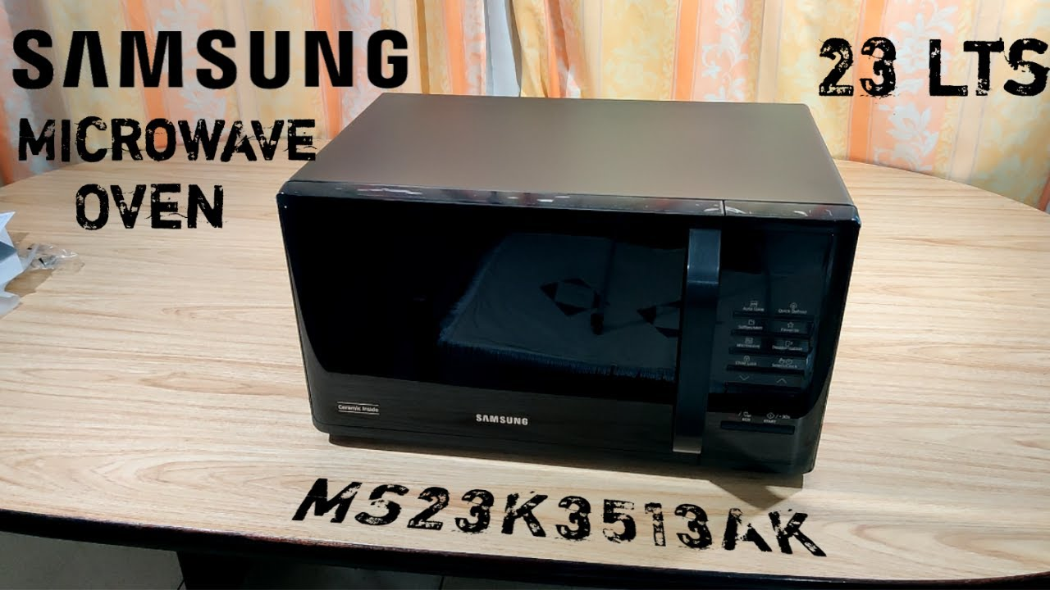
Most Viewed Videos
KB PRESENTS
Home
Profile
Dell Inspiron 5406 14 Inch Laptop | Core i7 11th Gen, Nvidia MX330 | 2n1 Touch Screen Light & Compact
Karan Bakrania
Most Viewed video
10:46
Library
Samsung Microwave Oven 23L MS23K3513AK Unboxing And Review
Karan Bakrania
Subscriptions
Trending
08:23
Help
Car Trunk LED Light Strip | Colorful RGB Dynamic Flowing LED Strip
Karan Bakrania
04:04

Slide 8
Help
KB PRESENTS
Search help
Home
help resources
Profile
Please let us know if you have any questions.
Feel free to contact us on Instagram if you need any further assistance and we will get back to you as quick as possible.
Most Viewed video
Library
Please let us know if you have any questions.
Feel free to comment below any video on our channel and we will get back to you with appropriate solution.
Subscriptions
Trending
Please let us know if you have any questions.
Feel free to leave a message on our WhatsApp number and we will assist you ASAP.
Help
Please let us know if you have any questions.
Feel free to leave a message on our Telegram and join our Channel to get all the latest information.

Slide 9
THANKS & REGARDS
 | Karan Bakrania Founder: KB Presents Content Creator Unboxing | Review | Teardown Email: karanbakrania31@gmail.com Web: www.youtube.com/KaranBakrania

